Slide 1
Machine Learning
DePaul IPD Program Lecture Course
Notes:
Stopped slide 65

Slide 2
Learning Goals
What are your learning goals from this class?
Notes:
Ask around, what are their learning goals from this course?

Slide 3
Learning Goals
What are your learning goals from this class?
When to apply machine learning (and when not to)
The limitations of machine learning
Understand what type of problem you are facing
How to evaluate the advantages and drawbacks of different algorithms
Know some of the main machine learning algorithms
Get excited about machine learning
Notes:
Ask around, what are their learning goals from this course?

Slide 4
Who Am I?
Dice.com’s Chief Data Scientist
> Data Science labs page (non proprietary stuff)
DePaul PhD Candidate - Machine Learning and NLP
Dissertation Topic: Natural Language Inference - Extracting Causal Inferences from Student Essays to Construct a Semantic Model

Slide 5
What is a Data Scientist? My Take
“A Business Analyst who lives in California.” (joke)
“A Statistician with a Mac”
Blend of statistics, machine learning, programming, BIG DATA, data visualization
Requires a broad breadth of experience in many different areas
Uses data to build data driven products, e.g.
Search engines
Recommender systems
Predictive models (e.g. weather forecasting, crime prediction)
Market Basket Analysis (customers who bought X, bought Y)

Slide 6
What is Big Data?

Slide 7
What is Big Data?
Dan Ariely (Social Scientist) - “It’s like teenage sex, everyone talks about, nobody knows how to do it, everyone thinks everyone else is doing it, so everyone claims to be doing it…”

Slide 8
What is Big Data?
Dan Ariely (Social Scientist) - “It’s like teenage sex, everyone talks about, nobody knows how to do it, everyone thinks everyone else is doing it, so everyone claims to be doing it…”
Data’s that too large to fit on a single machine or in memory

Slide 9
Overview
What is Machine Learning?
Types of Machine Learning Problems
Supervised Learning
Classification
Regression
Unsupervised Learning
Clustering
Dimensionality Reduction
Optimization
Reinforcement Learning
Limitations of Machine Learning
When to apply Machine Learning
What are the limitations
Notes:
Aim is to provide an overview of the different concepts, and then cover the core algorithms, using the algorithms to expand on the concepts introduced earlier.
Most of the early stuff won’t really make sense until they’ve seen some of the algorithm descriptions.

Slide 10
Overview
Bias Variance Trade Off
Bias
Variance
Definition of regularization
Introduction to Machine Learning Algorithms
Anatomy of an ML algorithm
Curse of Dimensionality
Important Attributes of a Machine Learning Algorithm to consider
Core Supervised Learning Algorithms
K-Nearest Neighbor
Trees
Linear and Logistic Regression
Linear Separability
What is a linear model?
Neural Network
SVM
Ensembles – what and why
Notes:
Briefly discuss Bias vs Variance and algorithm properties before going over in detail during the algorithms discussion
For the supervised learning algorithms – talk about re-occurring concepts in ML algorithms – similarity, entropy \ trees, least squares fit, additive models, separating hyperplanes, gradient descent

Slide 11
Overview (Time Permitting)
Feature Selection
Approaches to selecting features
Unsupervised Learning
Clustering – k means
Association Rule Mining
Dimensionality Reduction
Optimization
Genetic Algorithms
Other algorithms

Slide 12
Overview (Time Permitting)
Reinforcement Learning
Content Recommendations
Deep Learning
What is deep learning?
Extension from Neural Networks
When to consider deep learning, and when not

Slide 13
Teaching Strategy
Repetition
Introduce concepts early, demonstrate through many examples
Most concepts very abstract – make sense only when understand the basics of the algorithms
Consistency
Each model will be described in terms of a common set of characteristics that can be compared and evaluated
Each model can be seen to learn a decision boundary, visualizing the differences in the boundaries illuminates how the algorithms work in a very visual manner
Engagement
People learn better through active learning
In-class discussions, labs used to break up lecture flow, apply knowledge and add variation

Slide 14
What is Machine Learning?
Some example definitions:
Arthur Samuels (1959)
“Field of study that gives computers the ability to learn without being explicitly programmed”
Tom Mitchel (1999)
“A computer program is said to learn from experience E with respect to some class of tasks T and performance measure P, if its performance at tasks in T, as measured by P, improves with experience E”
Notes:
Tom Mitchel – i.e. the algorithm learns to reduce the number of mistakes (classification) or the size of the error from data

Slide 15
Is Machine Learning AI?
Arises from the 2 fields of artificial intelligence and statistics
The most commercially successful application of AI
Traditional AI deals with reasoning i.e. logical inference, game theory and planning.
Machine learning focuses on learning from data
Machine Learning in the Web
Some examples of machine learning:

Slide 16
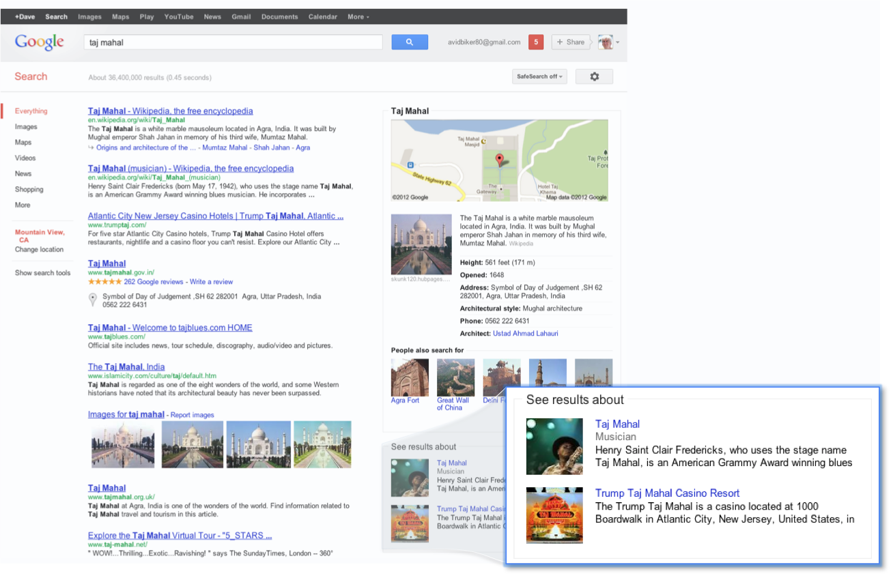
Google Search + Knowledge Graph
Notes:
PageRank is a machine learning algorithm

Slide 17
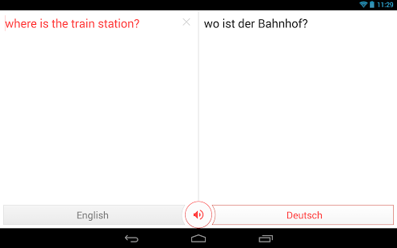
Google Translate

Slide 18
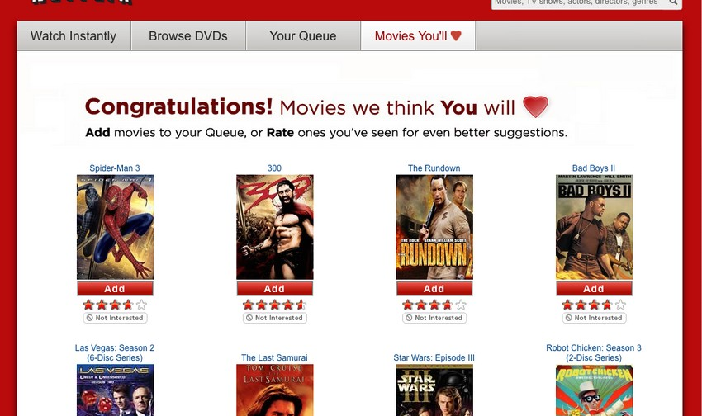
Netflix Movie Recommendations

Slide 19

Amazon’s “Customers … also bought”

Slide 20
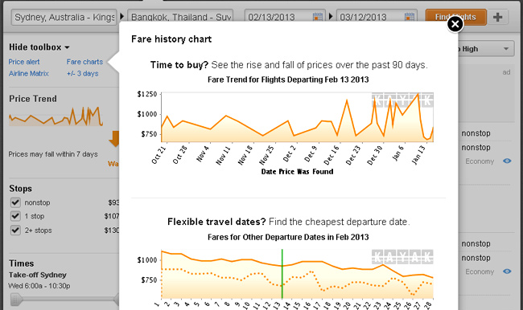
Kayak Fare Predictor

Slide 21
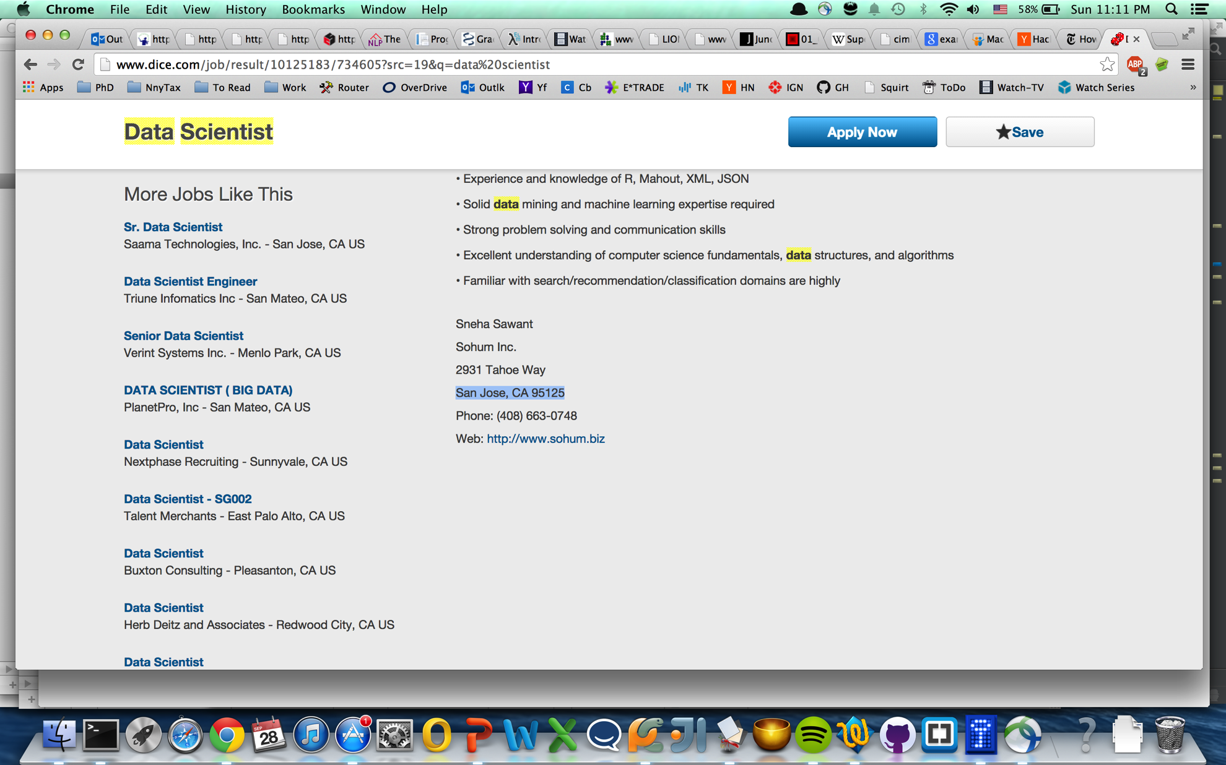
Dice More Jobs Like This

Slide 22
Supervised Learning
Mapping a set of inputs to a label
Predicting some event, label or numeric value, categorizing some items
E.g. predicting a person’s salary from their job description or determining the subject of a news article (sports, finance, news, etc)
Tabular View:
 | Col1 | Col2 | Col3 | Col… | Label (learn to predict)
Row1 | X1.1 | X1.2 | X1.3 | X1… | Label1
Row2 | X2.1 | X2.2 | X2.3 | X2… | Label2
Row… | … | … | … | … | …
RowN | XN.1 | XN.2 | XN.3 | XN… | LabelN

Slide 23
Why Do Machine Learning?
Automation of tasks previously requiring intelligence and domain expertise
Solve very hard problems that defy a programmatic solution
e.g. recent ILSVCR Google object recognition results (Imagenet dataset)
Consistent error rate
Adapt to changing conditions
e.g. stock market

Slide 24
Classification Problems
Classification
Predict a categorical (nominal) value
Binary
E.g. rain tomorrow? Yes/No Has Brain Tumor? True\False
Multiclass
E.g. What language is this document written in?
One vs Rest \ One vs All
One vs One
Multi-class, Multi-label
What entities are mentioned in this sentence? Places, People, Countries, Companies?
All strategies reducible to One vs Rest strategy
Regression
Predict a continuous variable (real number)
E.g. what will the price of gasoline be in a month? What will be the temperature tomorrow?

Slide 25
Unsupervised Learning
Finding patterns in data
Clustering: Grouping data points by similarity
Dimensionality Reduction: Projecting data into a lower dimensional space
Association Rules Mining: Find attributes that tend to occur together – market basket analysis
Can also be supervised with a target label
Optimization
Searching through potential solutions, to find the best solution to a problem
Best: Cheapest, fastest, shortest, etc
Important applications to optimizing machine learning algorithms

Slide 26
Reinforcement Learning
Learning to act optimally from interacting in some environment
Learning is usually online
Reward \ Punishment drives learning
Notes:
Example – training a car to race around a virtual track.

Slide 27
What Kind of Problem?
Supervised \ Unsupervised \ Optimization \ Reinforcement-Learning
Supervised : Classification \ Regression
Unsupervised : Clustering \ Dimensionality Reduction \ Association Rule Mining
Determining someone’s credit score
Accepting \ Denying car insurance coverage
Compressing a large dataset to speed up some machine learning algorithm
Is this document written in a positive, negative or neutral manner?
Discovering groups of similar users
Determining which books are bought together on an online bookstore
Learning to fly a drone
Predicting a second hand car’s value

Slide 28
What Kind of Problem…
Supervised \ Unsupervised \ Optimization \ Reinforcement-Learning
Supervised : Classification \ Regression
Unsupervised : Clustering \ Dimensionality Reduction \ Association Rule Mining
Predicting the value of the S&P tomorrow
Deciding what (letter) grade to assign an essay
A robot learning to navigate a maze
Deciding which content to display on an online news site
Finding the shortest route to deliver a set of parcels from a parcel delivery company
Deciding if a document is relevant to a search engine query
What set of investments will maximize my rate of return while reducing my risk profile
Tagging an image

Slide 29
Limitations of Machine Learning
Machine learning (ML) algorithms learn from historical data - equivalent to a observational study
Detects correlation NOT causation
“Correlation does not equal causation”
ML algorithms can indicate potential causal factors but..
Experiments – such as randomized controlled trials – required to determine causality

Slide 30
Why use Machine Learning?
Discuss

Slide 31
Why use Machine Learning?
Make predictions \ classifications from data (main use)
Indicate potential causal factors
Provide an possible interpretation for some phenomenon
Find unknown patterns in data

Slide 32
What is the Goal of Training a ML Algorithm
Discuss
Notes:
Question for class

Slide 33
What is the Goal of Training a Machine Learning Algorithm?
Generalization – create a model that generalizes to new unseen data
Train model on one dataset (training data), evaluate on second unseen dataset (validation dataset \ test dataset)
Performance on the validation data is all that matters
2 Challenges to achieving low out of sample error:
Overfitting (a.k.a. variance)
Model has memorized training data
Model has not generalized
Test analogy – model has memorized the questions and answers to some test, rather than understood the subject matter
Underfitting (a.k.a. bias)
Model structure is a poor fit for the problem
Two key ways this is manifested
Linear models on non-linear data, or the learner is unable to capture the structural shape of the problem
Independence assumptions between features that are highly inter-dependent
Notes:
Lead into linear models

Slide 34
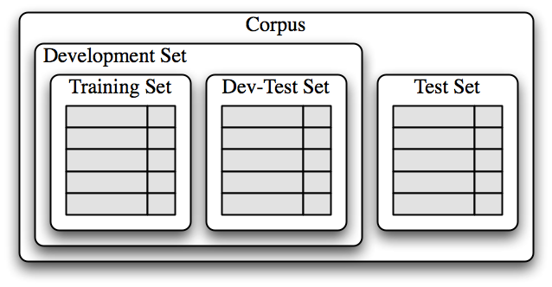
Training – Test Split
Notes:
From http://www.nltk.org/book/ch06.html last accessed 10.14.2014

Slide 35
How to Evaluate the Performance of An Algorithm?
Split the data into a training and a test set
Train the algorithm on the training set
Use the separate test set (validation set) to evaluate performance
Test set performance should closely match performance ‘in the wild’ as test data has not been seen before

Slide 36
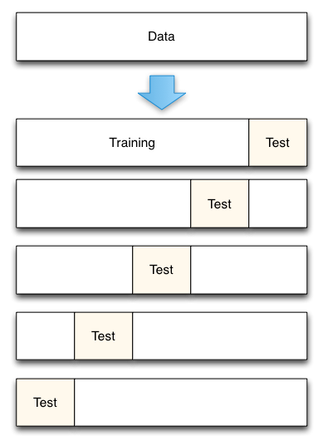
K-Fold Cross Validation
Notes:
From http://scott.fortmann-roe.com/docs/MeasuringError.html last accessed 10.14.2014

Slide 37
Regularization – Occam’s Razor
Simpler models are better
Simplify the model during or after training to improve generalization \ reduce over-fitting
‘Structural Risk Minimization Principal’
Will re-visit with each algorithm

Slide 38
Anatomy of a Machine Learning Algorithm
3 parts:
Model
The output of the learning algorithm
Used at run time to make predictions
Learning Algorithm
The algorithm that trains the model builds a tree, writes a program, sets some coefficients, adjusts some weights, etc
Loss function
Scores the model – guides learning
Absolutely crucial this is appropriate for the particular problem
Regression:
MAE
RMSE
Classification
Percentage Accuracy
0-1 loss
Cross entropy
F1 score

Slide 39
Important Characteristics of Machine Learning Algorithms
Prediction Accuracy on New Data
Performance at Scale
How well does the algorithm scale with the size of the data (number of data points and number of features)
Parallelizable?
Can the algorithm be parallelized?
Interpretability
How easy is the resulting model to understand by a human?
Classification algorithms – can it output a probability?
Bias \ Variance
Is the model powerful enough to handle the problem?
Is it prone to over-fitting?
Does it assume independence between features?
What type of data can it handle?
Inputs and output
Categorical?
Numerical?
Classification: Multiclass? Multi-label?
Can it learn effectively from high dimensional data?
Curse of dimensionality
Simplicity (ease of use)
How simple \ complex are the hyper parameters?

Slide 40
K-Nearest Neighbor Algorithm
Find the most similar k-data points, use them to compute a the label through voting
Uses a similarity metric
Given new data point, compute pairwise similarity to all other training data points
Voting Schemes:
Majority votes wins (k should be odd to resolve ties)
Weighted vote – votes are weighted by similarity

Slide 41
K-Nearest Neighbor Structure
Training Algorithm
No training – lazy learner
Model
Similarity based query at run time to find nearest neighbors
Aggregate neighbors to form prediction

Slide 42
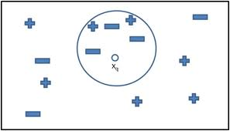
K-Nearest Neighbor Algorithm

Slide 43


Similarity \ Distance Metrics
Euclidean Distance:
Manhattan Distance
To get a similarity measure, compute:
Sim = 1/distance(x1,x2)
Sim = (1- distance(x1,x2)
if distance in [0,1]
Notes:
Equation images from wikipedia: http://en.wikipedia.org/wiki/Euclidean_distance - as of 10/6/2014

Slide 44
Iris Dataset – Compute Knn
Sepal Length | Sepal Width | Petal Length | Petal Width | Class
5.3 | 3.7 | 1.5 | 0.2 | Iris-setosa
5 | 3.3 | 1.4 | 0.2 | Iris-setosa
7 | 3.2 | 4.7 | 1.4 | Iris-versicolor
6.4 | 3.2 | 4.5 | 1.5 | Iris-versicolor
7.7 | 2.6 | 6.9 | 2.3 | Iris-virginica
6 | 2.2 | 5 | 1.5 | Iris-virginica
5.1 | 3.4 | 1.5 | 0.2 | ???
Compute:
Euclidean distance to each of 6 data points above
Which is the class assigned by k-nn for k = 1? k=4

Slide 45
Characteristics of Knn
Complete below - discuss
Prediction Accuracy on New Data
Performance at Scale
Parallelizable?
Interpretability
Bias \ Variance
What type of data can it handle?
Can it learn effectively from high dimensional data?
Simplicity (ease of use \ configuration)

Slide 46
Characteristics of Knn
Prediction Accuracy on New Data
Performance at Scale
Lazy learner – no training required so fast to train, but slow at runtime
Parallelizable?
Interpretability
Bias \ Variance
What type of data can it handle?
Can it learn effectively from high dimensional data?
Simplicity (ease of use \ configuration)

Slide 47
Characteristics of Knn
Prediction Accuracy on New Data
Performance at Scale
Lazy learner – no training required so fast to train, but slow at runtime
Parallelizable?
Yes
Interpretability
Bias \ Variance
What type of data can it handle?
Can it learn effectively from high dimensional data?
Simplicity (ease of use \ configuration)

Slide 48
Characteristics of Knn
Prediction Accuracy on New Data
Performance at Scale
Lazy learner – no training required so fast to train, but slow at runtime
Parallelizable?
Yes
Interpretability
Reasonable: Model can show similar instances from training data
Bias \ Variance
What type of data can it handle?
Can it learn effectively from high dimensional data?
Simplicity (ease of use \ configuration)

Slide 49
Characteristics of Knn
Prediction Accuracy on New Data
Performance at Scale
Lazy learner – no training required so fast to train, but slow at runtime
Parallelizable?
Yes
Interpretability
Reasonable: Model can show similar instances from training data
Bias \ Variance
Quite powerful – can handle non linear functions
Changing k can regularize (see ipython notebook)
Assumes feature independence – can’t learn combinations of features directly
What type of data can it handle?
Can it learn effectively from high dimensional data?
Simplicity (ease of use \ configuration)

Slide 50
Characteristics of Knn
Prediction Accuracy on New Data
Performance at Scale
Lazy learner – no training required so fast to train, but slow at runtime
Parallelizable?
Yes
Interpretability
Reasonable: Model can show similar instances from training data
Bias \ Variance
Quite powerful – can handle non linear functions
Changing k can regularize (see ipython notebook)
Assumes feature independence – can’t learn combinations of features directly
What type of data can it handle?
Any, needs an appropriate similarity metric
Requires feature normalization (see next slide)
Can it learn effectively from high dimensional data?
Simplicity (ease of use \ configuration)

Slide 51
Characteristics of Knn
Prediction Accuracy on New Data
Performance at Scale
Lazy learner – no training required so fast to train, but slow at runtime
Parallelizable?
Yes
Interpretability
Reasonable: Model can show similar instances from training data
Bias \ Variance
Quite powerful – can handle non linear functions
Changing k can regularize (see ipython notebook)
Assumes feature independence – can’t learn combinations of features directly
What type of data can it handle?
Any, needs an appropriate similarity metric
Requires feature normalization (see next slide)
Can it learn effectively from high dimensional data?
Not usually – often used with dimensionality reduction
Simplicity (ease of use \ configuration)
Notes:
Normaliz

Slide 52
Characteristics of Knn
Prediction Accuracy on New Data
Performance at Scale
Lazy learner – no training required so fast to train, but slow at runtime
Parallelizable?
Yes
Interpretability
Reasonable: Model can show similar instances from training data
Bias \ Variance
Quite powerful – can handle non linear functions
Changing k can regularize (see ipython notebook)
Assumes feature independence – can’t learn combinations of features directly
What type of data can it handle?
Any, needs an appropriate similarity metric
Requires feature normalization (see next slide)
Can it learn effectively from high dimensional data?
Not usually – often used with dimensionality reduction
Simplicity (ease of use \ configuration)
Pretty simple – 1 key hyper parameter (k neighbors), others include distance weighting function
Notes:
Normaliz

Slide 53
Knn- Regularization
Simple – increase k.
Illustrated later through the notebook

Slide 54


Feature Normalization
Knn needs data to be pre-processed
Data should be normalized
Standard Score normalization –
Feature Scaling –
What happens if data is not normalized?
Notes:
Why? Large data values dominate the
Equation images from wikipedia: http://en.wikipedia.org/wiki/Normalization_(statistics) - as of 10/6/2014

Slide 55
Iris Dataset – Feature Normalize
Sepal Length | Sepal Width | Petal Length | Petal Width | Class
5.3 | 3.7 | 1.5 | 0.2 | Iris-setosa
5 | 3.3 | 1.4 | 0.2 | Iris-setosa
7 | 3.2 | 4.7 | 1.4 | Iris-versicolor
6.4 | 3.2 | 4.5 | 1.5 | Iris-versicolor
7.7 | 2.6 | 6.9 | 2.3 | Iris-virginica
6 | 2.2 | 5 | 1.5 | Iris-virginica
Compute:
Normalize Sepal Length and Width using feature scaling
Compute min, max and max-min
Plug into

Slide 56
Decision Trees
Primarily a classification algorithm, but there are also regression trees (CART)
A tree structure is learnt where
Each node in the tree represents a split – a partition of the dataset by some attribute value
Going from the root to the leaves, the data is recursively partitioned
Leaves assign the class

Slide 57
Truth Tables - AND
A | B | A ^ B
T | T
T | F
F | T
F | F
Notes:
Complete truth table

Slide 58
Truth Tables - AND
A | B | A ^ B
T | T | T
T | F | F
F | T | F
F | F | F

Slide 59
Decision Tree for AND (Naïve)
True
A
False
True
False
True
False
B
B
TRUE
FALSE
FALSE
FALSE
Can we do better? Why?

Slide 60
Decision Tree for AND (Simpler)
True
A
False
True
False
B
FALSE
TRUE
FALSE
Notes:
Simpler as all leaves in the top false branch are of the same class (false)

Slide 61
Truth Tables - OR
A | B | A ^ B
T | T | T
T | F | T
F | T | T
F | F | F

Slide 62
Decision Tree for OR
True
A
False
True
False
B
TRUE
TRUE
FALSE
Notes:
Simpler as all leaves in the top false branch are of the same class (false)

Slide 63
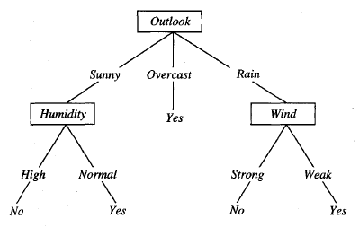
Decision Tree – Play Tennis?
Notes:
From http://www.netstorm.be/content/11/4/ (last accessed 10/8/2014)

Slide 64
How to Choose a Split
Split the data to make the distribution of classes more “pure”
Split on feature and attribute (feature value \ condition) that maximizes purity
Keep growing tree until each leaf contains only one class

Slide 65
20 Questions Game
http://en.wikipedia.org/wiki/Twenty_Questions#Computers.2C_scientific_method_and_situation_puzzles
The game suggests that the information (as measured by Shannon's entropy statistic) required to identify an arbitrary object is at most 20 bits. ...
Mathematically, if each question is structured to eliminate half the objects, 20 questions will allow the questioner to distinguish between 220 or 1,048,576 objects.
Accordingly, the most effective strategy for Twenty Questions is to ask questions that will split the field of remaining possibilities roughly in half each time.
The process is analogous to a binary search algorithm in computer science ....
E.g. http://www.20q.net/

Slide 66
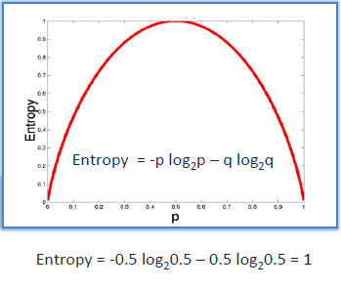
Entropy (Information Theory)
Term originates from thermodynamics, where is describes the amount of disorder in a system
This equation was defined by Claude Shannon to measure the amount of information stored in a data stream
The more disorganized or less uniform the data, the greater the entropy and the larger the number of bits required to store it
Notes:
From http://www.saedsayad.com/decision_tree.htm (last accessed 10/8/2014)

Slide 67
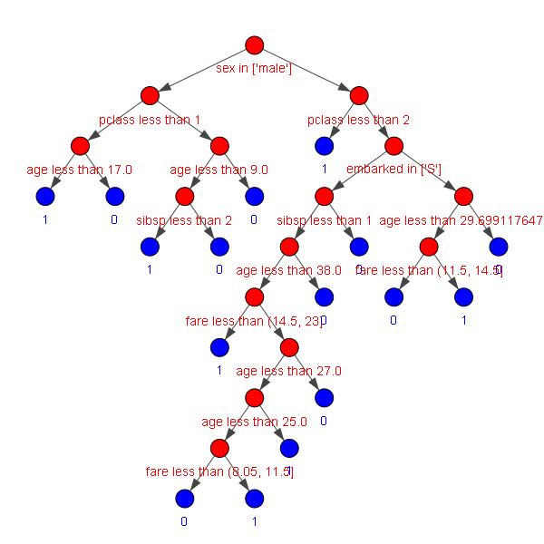
Kaggle Competition – Titanic Survivors
Notes:
Decision tree trained on the Kaggle Titanic dataset
Left branch yes, right branch no

Slide 68
Decision Tree - Structure
Training Algorithm
Iteratively choose binary splits that maximize the class purity in the leaves
Continue until all classes are the same for each leaf node
Model
A tree composed of if-then rules, analogous to a generated computer program
Evaluation starts at the root level, and propagates through a series of binary decisions to the leaves where the most common class is assigned

Slide 69
Characteristics of Decision Trees
Prediction Accuracy on New Data
Performance at Scale
Parallelizable?
Interpretability
Bias \ Variance
What type of data can it handle?
Can it learn effectively from high dimensional data?
Simplicity (ease of use \ configuration)

Slide 70
Characteristics of Decision Trees
Prediction Accuracy on New Data
Performance at Scale
Relatively fast to train, but depends on the data and the number of attributes in each column
Parallelizable?
Interpretability
Bias \ Variance
What type of data can it handle?
Can it learn effectively from high dimensional data?
Simplicity (ease of use \ configuration)

Slide 71
Characteristics of Decision Trees
Prediction Accuracy on New Data
Performance at Scale
Relatively fast to train, but depends on the data and the number of attributes in each column
Parallelizable?
Yes (e.g. thread per split)
Interpretability
Bias \ Variance
What type of data can it handle?
Can it learn effectively from high dimensional data?
Simplicity (ease of use \ configuration)

Slide 72
Characteristics of Decision Trees
Prediction Accuracy on New Data
Performance at Scale
Relatively fast to train, but depends on the data and the number of attributes in each column
Parallelizable?
Yes (e.g. thread per split)
Interpretability
One of the most interpretable models
Bias \ Variance
What type of data can it handle?
Can it learn effectively from high dimensional data?
Simplicity (ease of use \ configuration)

Slide 73
Characteristics of Decision Trees
Prediction Accuracy on New Data
Performance at Scale
Relatively fast to train, but depends on the data and the number of attributes in each column
Parallelizable?
Yes (e.g. thread per split)
Interpretability
One of the most interpretable models
Bias \ Variance
Low Bias \ High Variance – can memorize data easily, and combine features
What type of data can it handle?
Can it learn effectively from high dimensional data?
Simplicity (ease of use \ configuration)

Slide 74
Characteristics of Decision Trees
Prediction Accuracy on New Data
Performance at Scale
Relatively fast to train, but depends on the data and the number of attributes in each column
Parallelizable?
Yes (e.g. thread per split)
Interpretability
One of the most interpretable models
Bias \ Variance
Low Bias \ High Variance – can memorize data easily, and combine features
What type of data can it handle?
(Any) Input and Output : Nominal and Continuous
No normalization required
Can it learn effectively from high dimensional data?
Simplicity (ease of use \ configuration)

Slide 75
Characteristics of Decision Trees
Prediction Accuracy on New Data
Performance at Scale
Relatively fast to train, but depends on the data and the number of attributes in each column
Parallelizable?
Yes (e.g. thread per split)
Interpretability
One of the most interpretable models
Bias \ Variance
Low Bias \ High Variance – can memorize data easily, and combine features
What type of data can it handle?
(Any) Input and Output : Nominal and Continuous
No normalization required
Can it learn effectively from high dimensional data?
Yes – inbuilt feature selection algorithm in the way it splits on features
Simplicity (ease of use \ configuration)

Slide 76
Characteristics of Decision Trees
Prediction Accuracy on New Data
Performance at Scale
Relatively fast to train, but depends on the data and the number of attributes in each column
Parallelizable?
Yes (e.g. thread per split)
Interpretability
One of the most interpretable models
Bias \ Variance
Low Bias \ High Variance – can memorize data easily, and combine features
What type of data can it handle?
(Any) Input and Output : Nominal and Continuous
No normalization required
Can it learn effectively from high dimensional data?
Yes – inbuilt feature selection algorithm in the way it splits on features
Simplicity (ease of use \ configuration)
Again, pretty simple. Choice of split function (entropy, gini criterion).
Regularization - pre or post pruning

Slide 77
Pruning – Regularization for DT’s
High tendency to over-fit the data
But very powerful model, so can we do better?
Pre-Pruning:
Grow the tree until the difference in class distributions in the current split are not statistically significance
Post-Pruning:
Split training data into a training and a test set.
Grow the tree fully.
Try pruning each node in the tree, evaluate prediction accuracy on the test set, remove nodes where the test set prediction accuracy is not lower

Slide 78
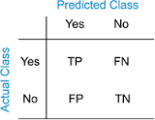
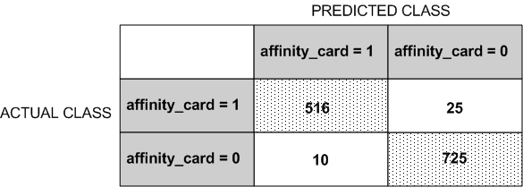
Confusion Matrix

Slide 79
Introduction to Weka
Download:
http://www.cs.waikato.ac.nz/ml/weka/downloading.html
Easy to use, fully featured GUI for doing machine learning on a dataset
Accepts various file formats, including *.csv files, and *.arff files
Some simple nice data visualization capabilities
Feature selection algorithms
Good for quickly testing an approach on a well curated dataset, not something I would use on a regular basis

Slide 80
Regression Models
Wide class of additive models that learn linear functions (straight lines \ hyper planes)
Fit a line using y = mx + c
m = gradient, i.e. how y changes depend on x
c = y intercept
Pick values for m and c that minimize the prediction errors
Generalizes to more than one input value, in which case you have many coefficients (m values)
Forms an additive model:

Slide 81
Linear Regression - Structure
Training Algorithm
Linear algebra to adjust coefficients such that the squared prediction error is minimized
Model
Additive, outputs the sum of each input feature * learned coefficient, plus the intercept term

Slide 82
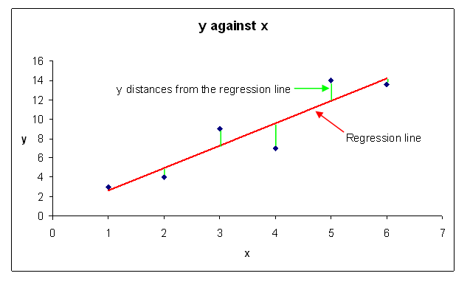
Least Squares Regression

Slide 83
Linear Regression - Notebook
See ipython notebook, for intuition about algorithm

Slide 84
Characteristics of Linear Regression
Prediction Accuracy on New Data
Performance at Scale
Parallelizable?
Interpretability
Bias \ Variance
What type of data can it handle?
Can it learn effectively from high dimensional data?
Simplicity (ease of use \ configuration)

Slide 85
Characteristics of Linear Regression
Prediction Accuracy on New Data
Performance at Scale
Fast and efficient. Closed form solution (one big matrix product)
Parallelizable?
Interpretability
Bias \ Variance
What type of data can it handle?
Can it learn effectively from high dimensional data?
Simplicity (ease of use \ configuration)

Slide 86
Characteristics of Linear Regression
Prediction Accuracy on New Data
Performance at Scale
Fast and efficient. Closed form solution (one big matrix product)
Parallelizable?
Yes, used at scale in big companies (e.g. Google)
Interpretability
Bias \ Variance
What type of data can it handle?
Can it learn effectively from high dimensional data?
Simplicity (ease of use \ configuration)

Slide 87
Characteristics of Linear Regression
Prediction Accuracy on New Data
Performance at Scale
Fast and efficient. Closed form solution (one big matrix product)
Parallelizable?
Yes, used at scale in big companies (e.g. Google)
Interpretability
Very interpretable. If the data is normalized first to lie within the same range, the relative sizes of coefficients indicates relative influence of features.
Bias \ Variance
What type of data can it handle?
Can it learn effectively from high dimensional data?
Simplicity (ease of use \ configuration)

Slide 88
Characteristics of Linear Regression
Prediction Accuracy on New Data
Performance at Scale
Fast and efficient. Closed form solution (one big matrix product)
Parallelizable?
Yes, used at scale in big companies (e.g. Google)
Interpretability
Very interpretable. If the data is normalized first to lie within the same range, the relative sizes of coefficients indicates relative influence of features.
Bias \ Variance
Linear model so a strong bias, cannot handle non-linearities
Model can also have high variance
What type of data can it handle?
Can it learn effectively from high dimensional data?
Simplicity (ease of use \ configuration)

Slide 89
Characteristics of Linear Regression
Prediction Accuracy on New Data
Performance at Scale
Fast and efficient. Closed form solution (one big matrix product)
Parallelizable?
Yes, used at scale in big companies (e.g. Google)
Interpretability
Very interpretable. If the data is normalized first to lie within the same range, the relative sizes of coefficients indicates relative influence of features.
Bias \ Variance
Linear model so a strong bias, cannot handle non-linearities
Model can also have high variance
What type of data can it handle?
Nominal data has to be encoded in one-hot representation
Outputs a continuous number so principally used for regression
No need to normalize data
Can it learn effectively from high dimensional data?
Simplicity (ease of use \ configuration)

Slide 90
Characteristics of Linear Regression
Prediction Accuracy on New Data
Performance at Scale
Fast and efficient. Closed form solution (one big matrix product) – can leverage vectorization
Parallelizable?
Yes, used at scale in big companies (e.g. Google)
Interpretability
Very interpretable. If the data is normalized first to lie within the same range, the relative sizes of coefficients indicates relative influence of features.
Bias \ Variance
Linear model so a strong bias, cannot handle non-linearities
Model can also have high variance
What type of data can it handle?
Continuous and nominal - nominal data has to be encoded in one-hot representation
Outputs a continuous number so principally used for regression
Can it learn effectively from high dimensional data?
Depends. Linear models like this tend to do well with high-dimensional data as strong bias counter-acts over-fitting. However, highly sensitive to noisy features
Simplicity (ease of use \ configuration)

Slide 91
Characteristics of Linear Regression
Prediction Accuracy on New Data
Performance at Scale
Fast and efficient. Closed form solution (one big matrix product) – can leverage vectorization
Parallelizable?
Yes, used at scale in big companies (e.g. Google)
Interpretability
Very interpretable. If the data is normalized first to lie within the same range, the relative sizes of coefficients indicates relative influence of features.
Bias \ Variance
Linear model so a strong bias, cannot handle non-linearities
Model can also have high variance
What type of data can it handle?
Continuous and nominal - nominal data has to be encoded in one-hot representation
Outputs a continuous number so principally used for regression
Can it learn effectively from high dimensional data?
Depends. Linear models like this tend to do well with high-dimensional data as strong bias counter-acts over-fitting. However, highly sensitive to noisy features
Simplicity (ease of use \ configuration)
Pretty simple, but depends on the linear regression variant (there are many).
I recommend ridge regression from personal experience as a first pass – 1 key parameter (alpha)

Slide 92
Linear Regression - Regularization
The complexity of the model is held in the size of the coefficients
Large variations in the coefficients can lead to high variance
Variance is defined mathematically as sensitivity to small changes in the inputs
i.e. a model with high variance can produce wildly different results with small changes in the input values
Solution: penalize large coefficient values – distributes the coefficient values more evenly
Different linear regression variants differ by regularization approach, ridge (L2), lasso (L1), elastic net (L1 + L2)

Slide 93
Logistic Regression
Additive model similar to linear regression, but for binary classification
Real number output from regression model is pushed through a sigmoid function – models the class probability

Slide 94
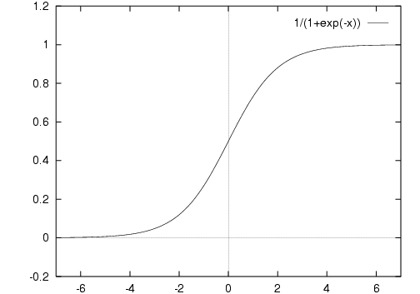
Sigmoid Function
S-shaped function used to ‘convert’ to a probability model
Notes:
From http://www.computing.dcu.ie/~humphrys/Notes/Neural/sigmoid.html last accessed 10.16.2014

Slide 95
Logistic Regression - Structure
Training Algorithm
Stochastic gradient descent (and other convex optimization algorithms)
Model
Additive model (series of coefficients + intercept), pushed through a sigmoid function

Slide 96
Characteristics of Logistic Regression
Prediction Accuracy on New Data
Performance at Scale
Parallelizable?
Interpretability
Bias \ Variance
What type of data can it handle?
Can it learn effectively from high dimensional data?
Simplicity (ease of use \ configuration)

Slide 97
Characteristics of Logistic Regression
Prediction Accuracy on New Data
Performance at Scale
Fast, but no closed for solution so slower than linear regression as iterative training procedure needed.
Parallelizable?
Interpretability
Bias \ Variance
What type of data can it handle?
Can it learn effectively from high dimensional data?
Simplicity (ease of use \ configuration)

Slide 98
Characteristics of Logistic Regression
Prediction Accuracy on New Data
Performance at Scale
Fast, but no closed for solution so slower than linear regression as iterative training procedure needed.
Parallelizable?
Can be easily parallelized (used by big companies e.g. google)
Interpretability
Bias \ Variance
What type of data can it handle?
Can it learn effectively from high dimensional data?
Simplicity (ease of use \ configuration)

Slide 99
Characteristics of Logistic Regression
Prediction Accuracy on New Data
Performance at Scale
Fast, but no closed for solution so slower than linear regression as iterative training procedure needed.
Parallelizable?
Can be easily parallelized (used by big companies e.g. google)
Interpretability
Series of coefficients that represent relative feature importance
Bias \ Variance
Linear model, thus high bias
Can have high variance
What type of data can it handle?
Can it learn effectively from high dimensional data?
Simplicity (ease of use \ configuration)

Slide 100
Characteristics of Logistic Regression
Prediction Accuracy on New Data
Performance at Scale
Fast, but no closed for solution so slower than linear regression as iterative training procedure needed.
Parallelizable?
Can be easily parallelized (used by big companies e.g. google)
Interpretability
Series of coefficients that represent relative feature importance
Bias \ Variance
Linear model, thus high bias
Can have high variance
What type of data can it handle?
Continuous and nominal - nominal data has to be encoded in one-hot representation
Outputs a continuous number so principally used for regression
Can it learn effectively from high dimensional data?
Simplicity (ease of use \ configuration)

Slide 101
Characteristics of Logistic Regression
Prediction Accuracy on New Data
Performance at Scale
Fast, but no closed for solution so slower than linear regression as iterative training procedure needed.
Parallelizable?
Can be easily parallelized (used by big companies e.g. google)
Interpretability
Series of coefficients that represent relative feature importance
Bias \ Variance
Linear model, thus high bias
Can have high variance
What type of data can it handle?
Continuous and nominal - nominal data has to be encoded in one-hot representation
Outputs a continuous number so principally used for regression
Can it learn effectively from high dimensional data?
Depends. Linear models like this tend to do well with high-dimensional data as strong bias counteracts over-fitting. However, highly sensitive to noisy features
Simplicity (ease of use \ configuration)

Slide 102
Characteristics of Logistic Regression
Prediction Accuracy on New Data
Performance at Scale
Fast, but no closed for solution so slower than linear regression as iterative training procedure needed.
Parallelizable?
Can be easily parallelized (used by big companies e.g. google)
Interpretability
Series of coefficients that represent relative feature importance
Bias \ Variance
Linear model, thus high bias
Can have high variance
What type of data can it handle?
Continuous and nominal - nominal data has to be encoded in one-hot representation
Outputs a continuous number so principally used for regression
Can it learn effectively from high dimensional data?
Depends. Linear models like this tend to do well with high-dimensional data as strong bias counteracts over-fitting. However, highly sensitive to noisy features
Simplicity (ease of use \ configuration)
Pretty simple, but depends on the linear regression variant (there are many).
I recommend ridge regression from personal experience as a first pass – 1 key parameter (alpha)

Slide 103
Logistic Regression - Regularization
Same exact strategy to linear regression as model structure is the same (minus sigmoid function)

Slide 104
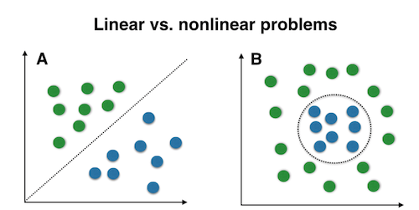
Linear \ Nonlinear
Notes:
From http://sebastianraschka.com/Images/2014_kernel_pca/linear_vs_nonlinear.png – last accessed 10.18.2014

Slide 105
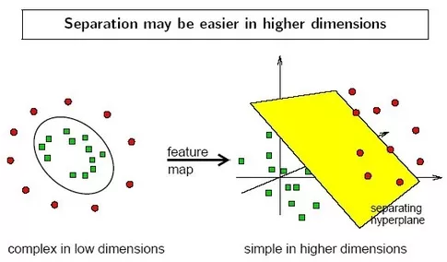
Linear \ Nonlinear
Notes:
From http://www.quora.com/How-does-the-Kernel-Trick-enable-SVMs-to-perform-non-linear-classification – last accessed 10.18.2014

Slide 106
Decision Boundaries - Notebook
Linear separability
Regularization
More data as a form of regularization

Slide 107
Lab Exercise - Decision Trees in Action
Nominal Data: Load play tennis dataset into weka
http://axon.cs.byu.edu/~martinez/classes/478/stuff/labhints/tennis.arff
Load iris dataset into weka
http://mlr.cs.umass.edu/ml/machine-learning-databases/iris/iris.data
Kaggle Titanic Data
https://github.com/birchsport/titanic/blob/master/test.arff
Note: data is imbalanced (290 survived, 1911 died)

Slide 108
Making a Linear Classifier Handle Non-Linear Data
You can give a linear model the power to learn non-linear functions by extracting additional non-linear features
E.g. in linear regression, adding polynomial terms
https://tonyfischetti.shinyapps.io/InteractiveLogisticRegression/
Similarly if you model assumes feature independence, you can add cross-product features (combinations of features)
E.g. adding bi-grams to a vector space model

Slide 109
Feature Selection
Univariate
Statistical Measures (correlation with class, chi squared, etc)
Multivariate
Evaluate groups of features in combination
Model based (embedded)
Brute force
Try all combinations
Intractable with more than a few features ( O(n!/(k!(n-k)!)) – factorial in the size of features)
Sequentially add \ remove features
2 approaches
Forward selection (add one by one)
Backwards selection (add all, selectively remove)
Selection approaches
Greedy (hill climbing – add best \ remove worse)
Random
Use an optimization algorithm
Simulated Annealing
Genetic Algorithm
Etc
Dimensionality Reduction
Unsupervised (PCA, truncated SVD, NNMF)
Supervised (Linear Discriminant Analysis, plus others)
Discussed more in unsupervised learning section

Slide 110
ML Week 1 Review
What is regularization?
Do machine learning models detect correlation or causation between the inputs and the output?
Explain bias
Name an algorithm that’s good at solving problems where combinations of features are predictive
What is the curse of dimensionality? Name one algorithm that typically under-performs in high-dimensions
You want to look for job titles that people tend to search for together. What type of problem is this?
Name a regularization strategy for a decision tree
Why is feature scaling important? Give an example
What is the key goal of supervised learning?

